Slide 1
Maintenance of Certification
Welcome
In the chat box, please
share the following…
Name
Certificate Area
Notes:
Lisa

Slide 2
Agenda
Why MOC
Eligibility and Important Documents
Difference Between Initial and MOC
Overview of Components
Professional Growth Experiences (PGEs)
Component 1
Component 2
Writing
Submission
Pandemic Flexibility
Supports

Slide 3
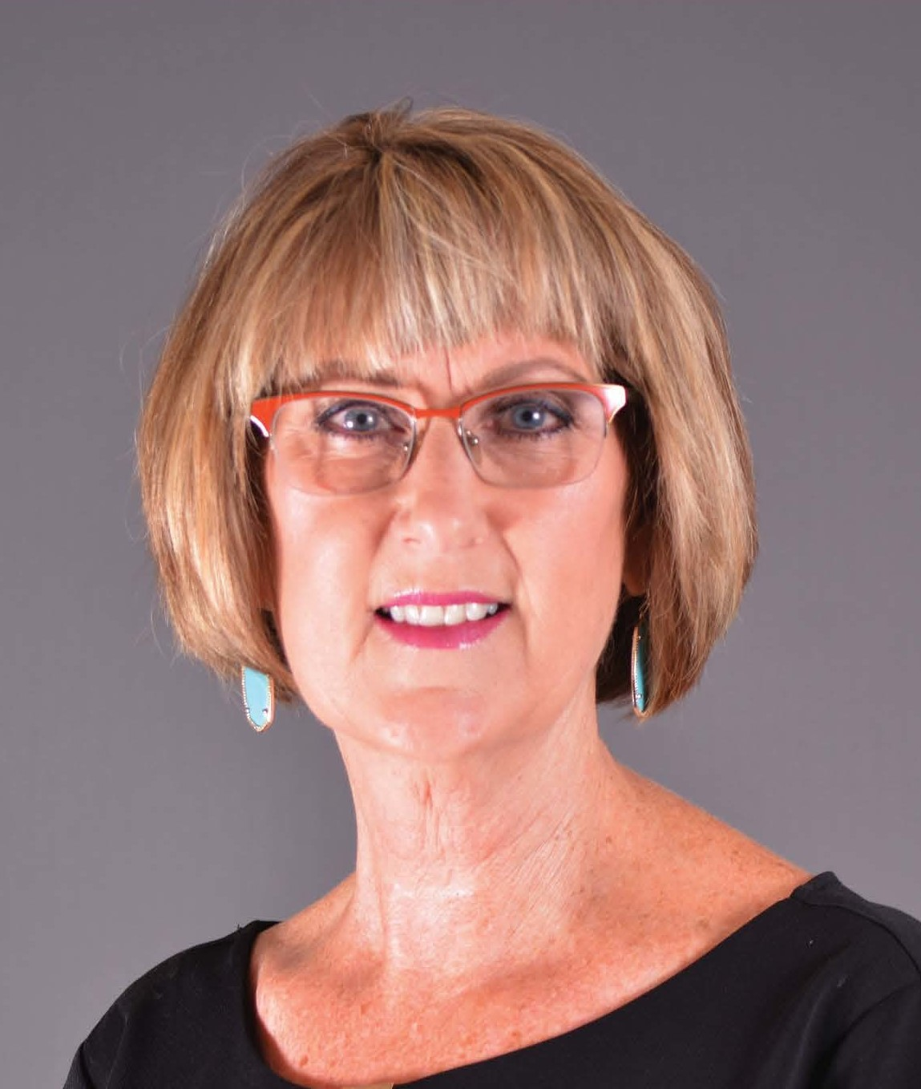
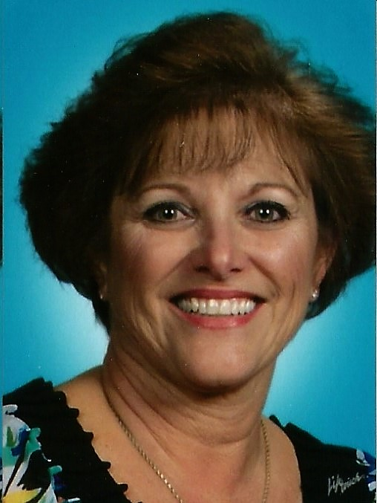
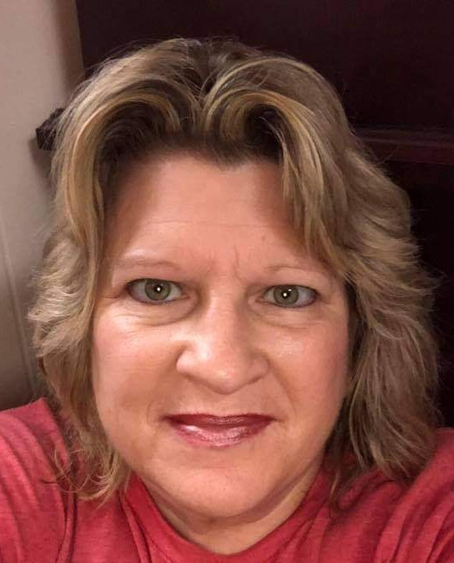
Renewal Trainers
Susanne Silk, NBCT
CT/EAYA
Sheila Treadwell, NBCT
EC-GEN
Kenda Bates, NBCT
ELA/AYA

Slide 4
What are your peers saying?
A 50-hour time commitment isn’t too bad, and the cost is lower than the renewal was.
I want to continue my status of NBCT. I feel that teachers need to always be learning and evaluating themselves. How can I help my students grow as learners?
The process is manageable and worthwhile…will help me grow as teacher and professional.
I believe MOC will help me focus on my teaching and my classroom and refine my processes.
Notes:
Lisa

Slide 5
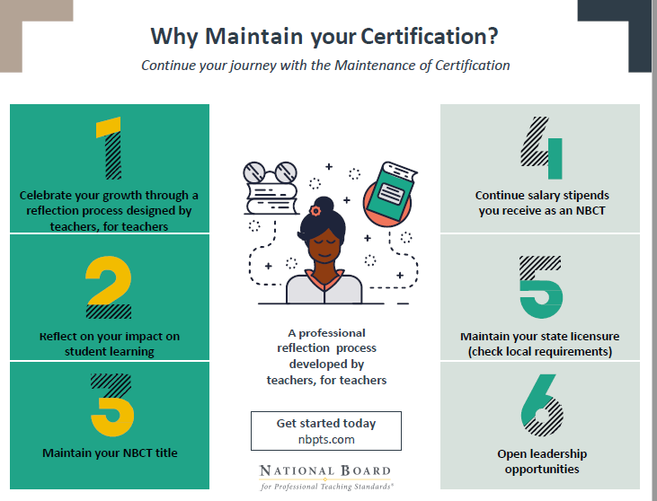
Notes:
Lisa

Slide 6
March 31, 2021
More Detailed Calendar
https://www.nbpts.org/wp-content/uploads/MOC-Calendar.pdf
Notes:
Lisa

Slide 7
There are two options for when to submit MOC
Apply for MOC starting in the fall two years before your current certificate expires and submit your MOC evidence in May in the year before your current certificate expires. For example, if your certificate expires in 2022, you would apply between September 2020 and February 2021 and submit your MOC evidence in May 2021.
Apply for MOC in starting in the fall the year before your current certificate expires and submit your evidence in May in the year your current certification expires. For example, if your certificate expires in 2022, you would apply between September 2021 and February 2022 and submit your MOC evidence in May 2022.
Notes:
Lisa

Slide 8
Verify Certificate & Contact Information
https://www.nbpts.org/log-in/
Notes:
Lisa

Slide 9
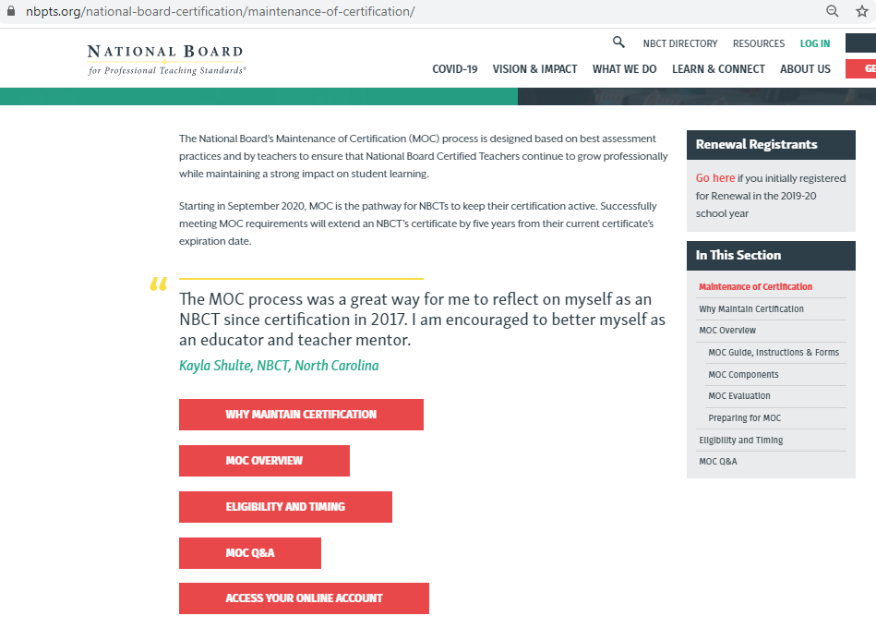
Notes:
Lisa

Slide 10
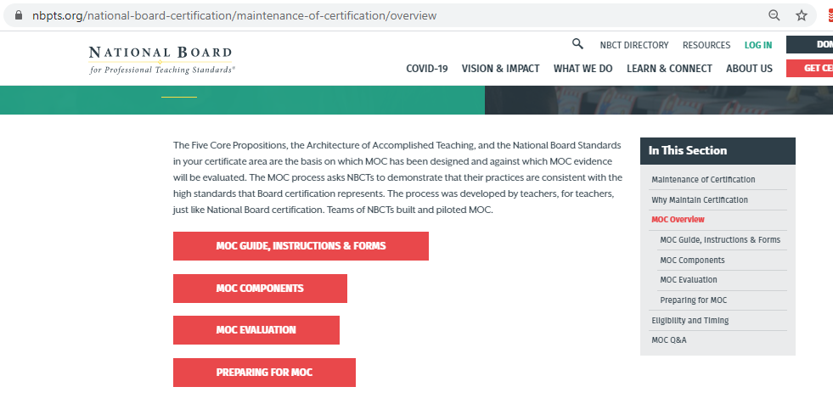
Notes:
Lisa

Slide 11
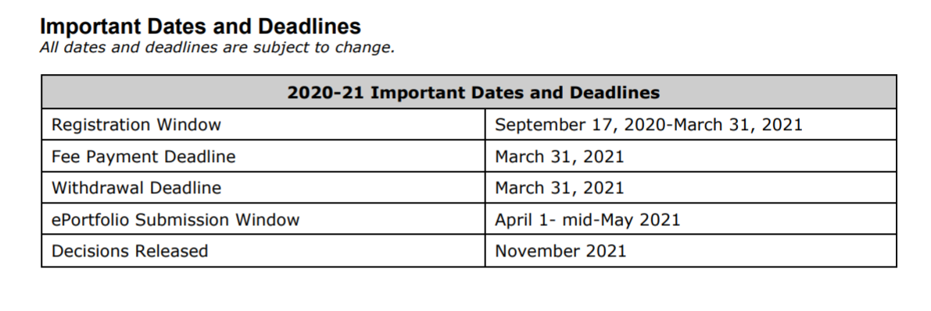
MOC Important Dates and Deadlines
MOC Guide, page 2
Notes:
Lisa

Slide 12
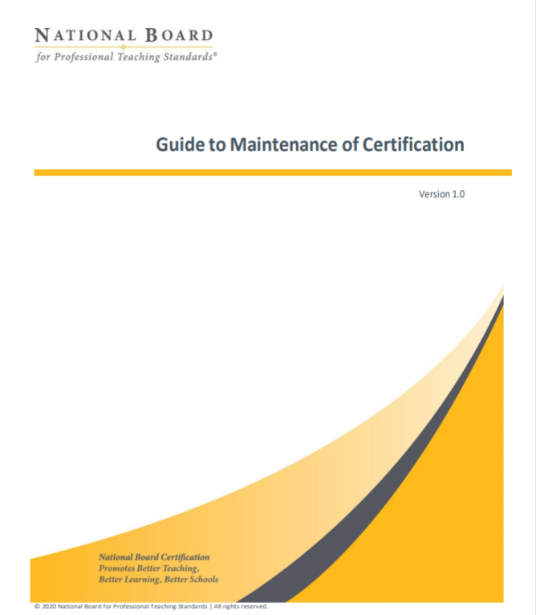
Important Details
Registration
Fee
Incentives
National Board Policies (including ethics and accommodations)
National Board Candidate Management System
Guide to Maintenance of Certification
Notes:
Tanya

Slide 13
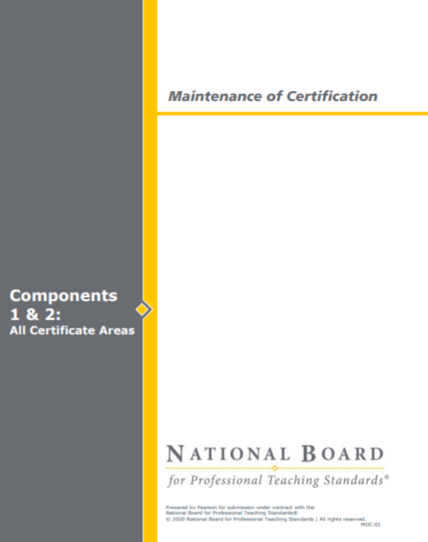
Important Details
Requirements
Policies and Guidelines
Rubric
Instructions for Developing Component 1 and 2
Checklist
Submission Information
Maintenance of Certification Instructions
Notes:
Tanya

Slide 14
Initial Certification | Maintenance of Certification
4 Components | 2 Components
Individual Component Evaluation | Holistic Evaluation
Clear, Consistent, Convincing Evidence | Sufficient Evidence
Numerical Score | Maintain/Not Maintain Decision (with feedback)
Assessment Center | No Assessment Center
Initial Cost $1,975 (minimum) | MOC Cost $495 + $75 registration ($570 total)
Estimated Hours 200+ hours | Estimated Hours 50+ hours
Notes:
Tanya

Slide 15
Maintenance of Certification is
NOT RE-Certifying
You are keeping your certificate active – not recertifying.
MOC measures how you, as an NBCT, have continued to grow in your professional experiences, with a focus on positively impacting student learning.
This means you are providing evidence that your teaching practice still exemplifies your certificate area standards, the Architecture of Accomplished Teaching, and the NBPTS Five Core Propositions.
Remember, you’ve already demonstrated that you are an accomplished teacher.
Make sure to read the MOC Instructions, page 1
Notes:
Tanya

Slide 16
Vocabulary
MOC: Maintenance of Certification
PGE: A Professional Growth Experience is an activity in which you learn something new that has influence within or beyond the classroom and has a DIRECT or INDIRECT impact on student learning.
SOP: Samples of Products, which are documents used as evidence to provide clarification and/or enhancement of the PGE
Notes:
Tanya

Slide 17
Notes:
Tanya

Slide 18
Notes:
Melissa S

Slide 19
MOC Components
The MOC process consists of a portfolio submission of two components. These two components draw upon two Professional Growth Experiences (PGEs) must demonstrate that your professional growth continues to align with the Five Core Propositions, the Architecture of Accomplished Teaching, and the current National Board Standards in your original certificate (content and developmental) area.
Notes:
Melissa S

Slide 20
Professional Growth Experiences (PGEs)
What is a PGE?
An activity in which you learned something new that has influence within or beyond the classroom and had a direct or indirect impact on student learning.
MOC Instructions, pgs 4-8 in the for more details on PGEs.
Notes:
Melissa s

Slide 21
Professional Growth Experiences
PGEs should show…
New learning (ongoing, evolving, and varied)
Influence within or beyond the classroom
Direct or indirect impact on student learning
Both PGEs must show professional growth align with the Five Core Propositions, the Architecture of Accomplished Teaching, and the current National Board Standards in your original certificate (content and developmental) area.
Read pages 4-8 in the MOC Instructions for more details on PGEs.
Select PGEs that allow you to showcase not just your accomplishments, but what you did—what steps you took, what milestones you achieved—to reach that level of accomplishment.
Notes:
Melissa s
Facilitator should remind candidates to reference the instructions directly. (P. 4 of Instructions)

Slide 22
PGEs
These experiences may have begun before certification or at a later point, but they should have evolved to become an important focus of your professional growth since initial certification or since renewal.
Notes:
Melissa s

Slide 23
Examples of PGEs
obtain a grant for and implement a special project in your school
organize family or community activities related to supporting students or providing equitable access to education
provide mentoring, coaching, or other training to new teachers on an ongoing basis
play a significant role in special projects at the school, district, or higher level that had a positive impact on students
perform a needs analysis for instructional resources and develop a plan based on the results
conduct research that led to changes in your or others’ instructional practice
collaborate with colleagues, community members, and/or families to meet the needs of students
create a website that is actively used by students and families to facilitate regular communication between school and home
MOC Instructions, page 4
Notes:
Melissa s
Facilitator should remind candidates to reference the instructions directly. (P.4 for PEs and 7 of Instructions)
Emphasize that it’s all about connecting the PGE to student learning

Slide 24
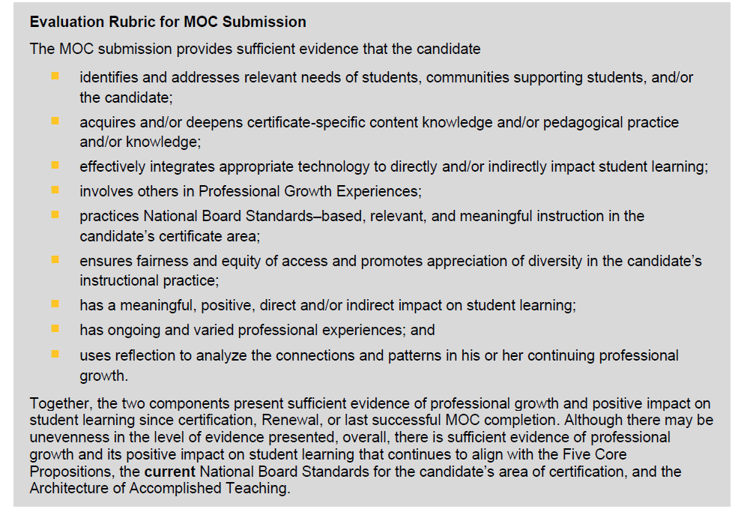
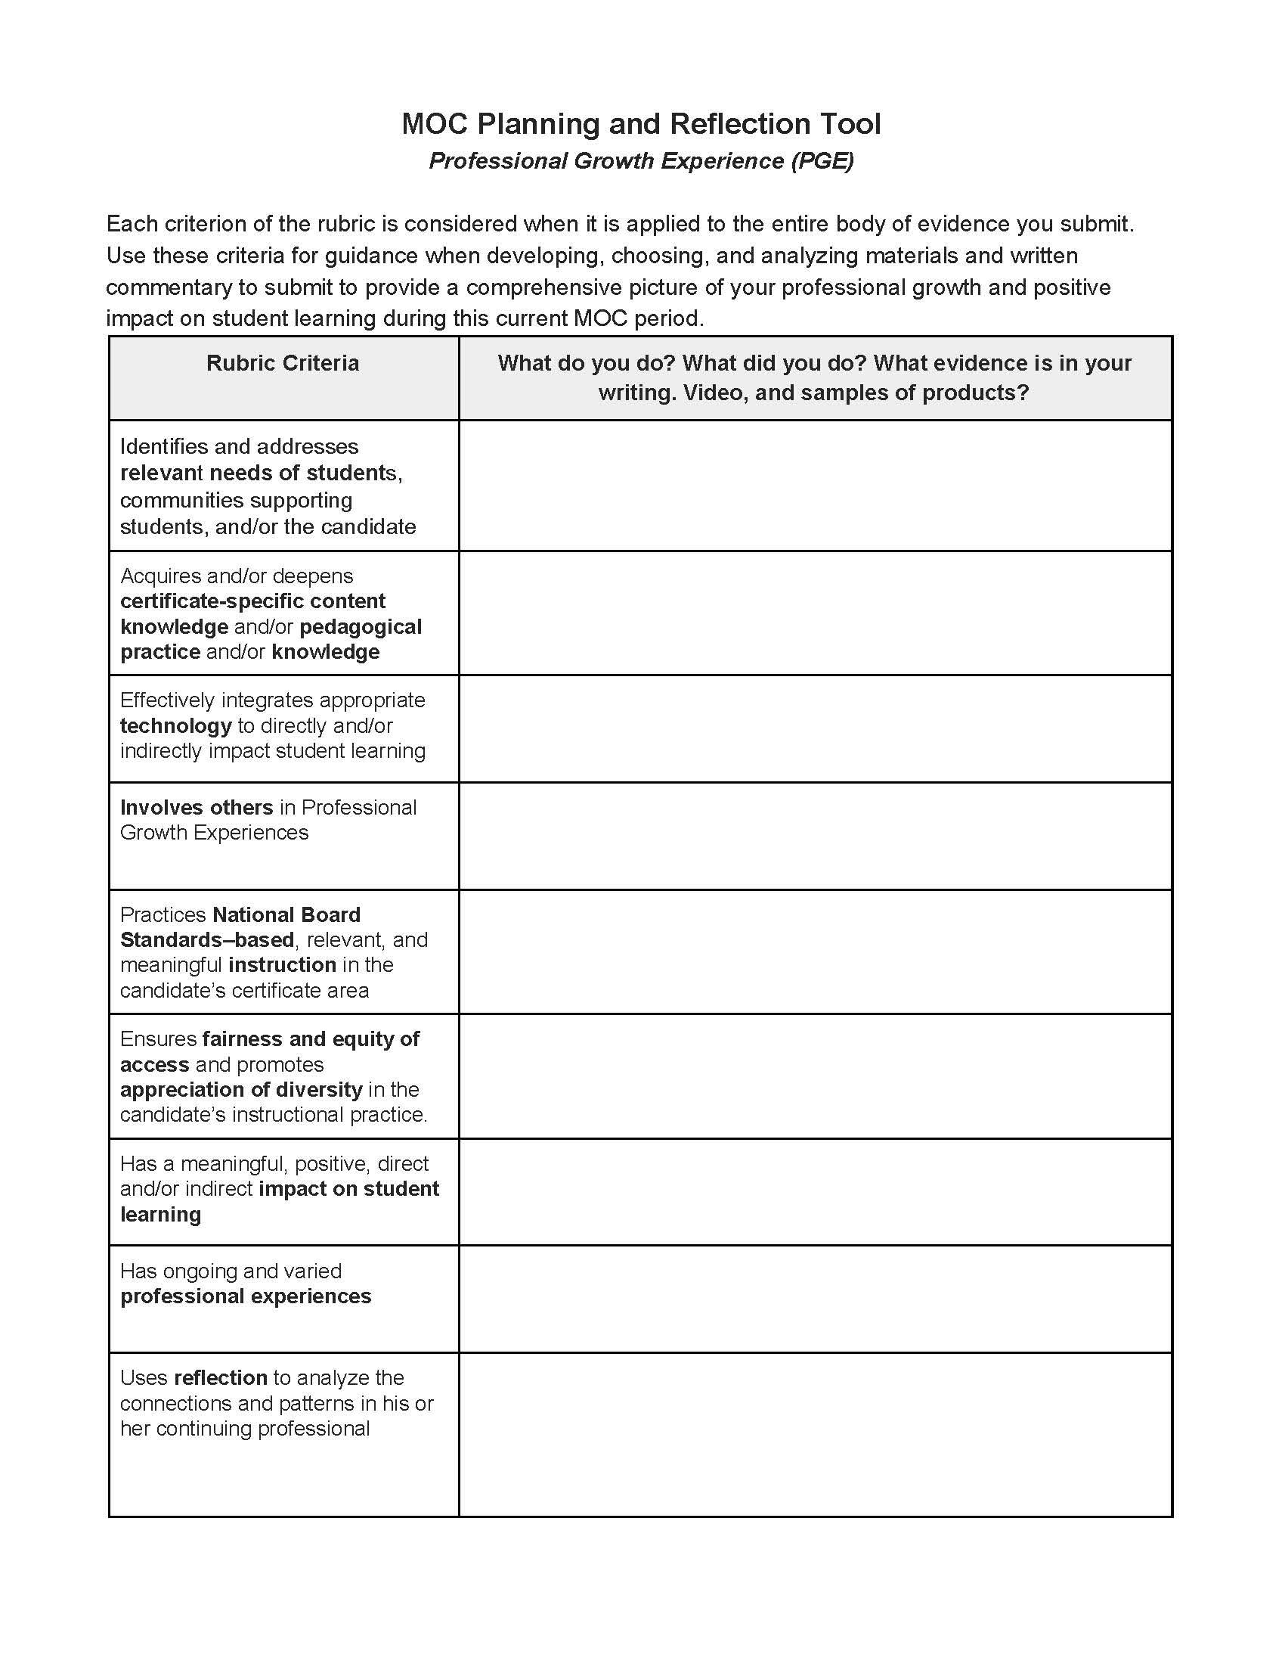
Planning and Reflection Tool
Start Planning
MOC Instructions, pages 13-15
Notes:
Melissa s
Graphic Organizer: https://docs.google.com/document/d/1hcQC7w1isEO1FS4xQHwiUurEQ4Jfemak182WjcDcy1U/copy
The wording for the Rubric Criteria of this document is pulled directly from the rubric on page 13. This tool can be used as a planning document when selecting candidate PGEs. For example, does your selected PGE explicitly address a need and can you provide evidence for that need? Does your PGE consider how you provide equity of access to content based on pedagogical needs and can you provide evidence?
Once a PGE is written, this tool can be used to ensure that each element from the rubric has been addressed with evidence.

Slide 25
Examples of Samples of Products (SOPs)
Appropriate types of evidence may include, but are not limited to the following:
student work products (e.g., examples of students’ writing, artwork, self-reflections on their learning, three-dimensional work products)
photographs of non-text student work (e.g., artwork, engineering design product) or of students engaged in learning activities
student test scores or other measures of students’ performance
testimonials from teachers or other staff regarding outcomes related to implementation of training/mentoring you have provided
emails from students’ families
quantitative or qualitative data related to student engagement or attitudes toward learning
attendance and/or graduation rates
outcomes for particular student populations
data related to use of resources (e.g., library, technology) in support of student learning
an excerpt of a website, a blog, or an article or paper that you wrote or created
a summary of the outcomes of a project you worked on or implemented
MOC Instructions, page 8. Details on size of documents page 11
Notes:
Melissa s

Slide 26
Notes:
Melissa P

Slide 27
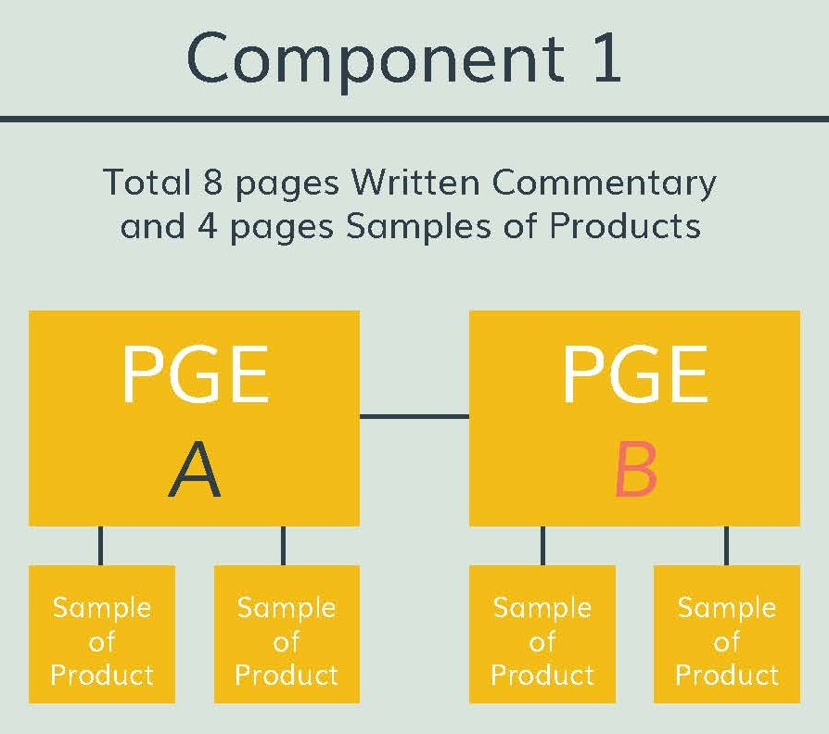
Component One
Deep Dive
Notes:
Melissa P

Slide 28
Component One
4 pages of Written Commentary per PGE (8 pages total)
Written Commentary must be submitted in provided template
2 pages of Samples of Products (SOP) per PGE
12 pages total
MOC Instructions, pages 16-20, 26-27
Notes:
Melissa P

Slide 29
PGE Written Commentary
For each PGE Written Commentary, a candidate is required to answer these five questions.
Provide a context of the professional situation that indicates what need(s) of students, the professional community, parents/guardians, and/or yourself you are addressing with each PGE.
Describe each PGE and how each of your PGEs demonstrates a response to the identified need(s).
In the context of each of your PGEs, explain how you have acquired and deepened your certificate area-specific content knowledge and/or your pedagogical knowledge and skills to remain current, including use of research and/or use of other professional activities.
Analyze ways in which each of your PGEs and related activities positively impacted student learning whether directly or indirectly.
Reflect on each of the PGEs presented, and on changes, additions, and/or next steps that would enhance your professional growth in the future.
MOC Instructions, page 17
Notes:
Melissa P
Facilitator should remind candidates to reference the instructions directly. (P. 17 of Instructions)
Candidates often question the term context. Provide a working explanation of this term.
Context provides a big picture/background or the why of the identified need. The need provides a more detailed explanation of what needs to be addressed and the why.
Example of CONTEXT: The global pandemic has required teachers to explore virtual/remote teaching and learning opportunities.
Example of NEED: Students need to have more opportunities to engage with content during virtual settings to scaffold and comprehend content.
Example of RESPONSE to the NEED/PGE: Teacher engages in or leads professional development exploring best practices to engage students in virtual learning.

Slide 30
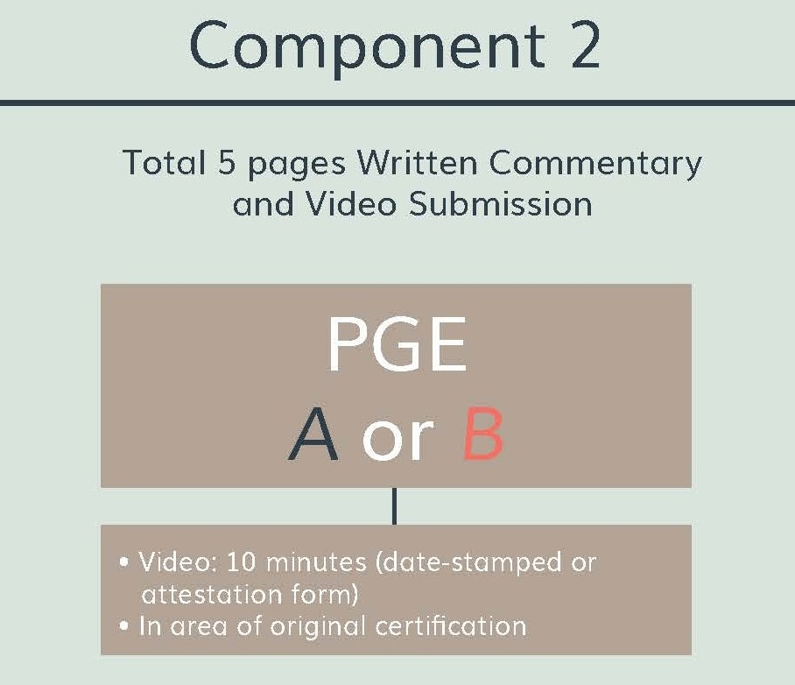
Component Two
Deep Dive
Notes:
Melissa S

Slide 31
Component Two
Written Commentary
No More than 5 Pages
Video
10 Minute Max
Notes:
Melissa S
Facilitator should remind candidates to reference the instructions directly. (P. 21-25 of Instructions)

Slide 32
Component Two Video
Design a lesson in your original certification area
Can be recorded no earlier than September 1 in the year prior to your first year of MOC eligibility (two years before your certificate expires)
Can be segmented into 3 parts (10 minutes max)
Must be date stamped (or have attestation form)
Must show you and your students together in at least one segment, your students interacting with one another, your students’ reactions to what you are doing, and their engagement in learning
MOC Instructions, pages 20-25, 27
Notes:
Melissa S
Facilitator should remind candidates to reference the instructions directly. (P. 20-25 and 27 of Instructions)

Slide 33
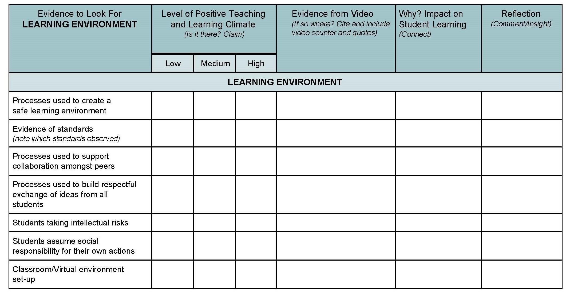
Component Two
Video Graphic Organizer
Capture the Evidence
Learning Environment
Student Engagement
Instruction
MOC Instructions, pages 20-25, 27
Notes:
Melissa S
Graphic Organizer link: https://docs.google.com/document/d/1PvF4M4q-_Tlv5hsBGEYzus2ypwMp0EbQbENt3YH-gU8/copy
Facilitator remind candidates to reference the instructions directly. (P. 19 of Instructions). This graphic organizer is a tool that candidates can use as a checklist to determine level of evidence captured in video through three lenses:
the learning environment,
Student engagement,
instruction.
REMINDERS:
Candidates should:
Analyze student work/video using the lens of the National Board core propositions and standards.
Analyze student work/video using the lens of the Architecture of Accomplished Teaching (AAT).
https://docs.google.com/document/d/1PvF4M4q-_Tlv5hsBGEYzus2ypwMp0EbQbENt3YH-gU8/edit

Slide 34
Component Two Prompts
How has your learning or professional growth, as described in the PGE, been applied in this lesson?
For the featured lesson, what were your goals, and how did they fit into the broader context of learning for these students?
Why is this instruction important for these students at this particular point in time?
How did you ensure fairness and equity of access, and promote appreciation of diversity among the students?
How does the video recording reflect your certificate-specific content knowledge?
Explain the impact of your teaching on student learning. Cite specific examples from the video recording and identify what they illustrate.
Reflecting on the activity presented in the video, discuss any changes and/or additions that would have enhanced student learning.
Reflecting on the activity presented in the video, discuss any changes, additions, and/or next steps that would enhance your professional growth in the future.
Pgs. 20-21 of MOC Instructions
MOC Instructions, page 24
Notes:
Melissa S
Facilitator should remind candidates to reference the instructions directly. (P. 20-21 of Instructions)

Slide 35
What is the foundation of the MOC process?
Five Core Propositions
Architecture of Accomplished Teaching
Current National Board Standards for the original certificate area
Professional Growth Experiences
Notes:
Tanya

Slide 36
Engaging with Five Core Propositions
Read the explication of the Five Core Propositions in What Teachers Should Know and Be Able to Do
Begin with a self-assessment (this is a survey that will require you to make your own copy before you can take it)
Then re-read and annotate one of the 5 Core Propositions
Notes:
Tanya-
As you review the 5 Core propositions you may want to take this self assessment to reconnect with the Five Core Propositions

Slide 37
Digging Into Your Standards
Take out your standards. Use a highlighter…
GREEN: All the elements you can demonstrate evidence in your practice
YELLOW: Elements you have been working on since your initial certification or most recent renewal
RED: Elements you need to keep building or might seek professional development opportunities for
YELLOW: Might be good elements to consider for PGEs
Component 2
Written Commentary (up to 5 pages)
+
Video (up to 10 minutes)
Notes:
Tanya - As you Review your standards. This strategy might help… The Standards bring core propositions to life in a variety of classroom settings. They identify knowledge, skills, and dispositions that support performance at a high level.

Slide 38
Three Types of Writing
Descriptive
Sets the scene.
Response to “what?,” “which?,” “describe,” “state,” or “list.”
Analytical
Details your thought process.
Response to “why?”
Explains the significance
Reflective
Based on what you have learned from past experience, how will you do things differently?
MOC Instructions, page 30
Notes:
Tanya
Facilitator should remind candidates to reference the instructions directly. (Appendix A: P. 26 of Instructions)

Slide 39
USING MEASURABLE VERBS Ask yourself: Why? Why? Why?
How? What impact to student observed? What changes did you make?
Good | Better
I have shown students how to do a math problem. | I modeled the correct procedure for completing the math problem.
My students worked in small groups to discuss the characters in the book. | My students brainstormed characters of the book using our class group protocol.
I decided how to organize my lesson based on the students’ disabilities in my classroom. | I differentiate my instruction based on my students’ learning profile, to accommodate his or her need(s).
Students showed growth on their test. I worked with students who performed at a lower level. | After analyzing the formative assessment results, I designed individualized support sessions for my students scoring below 75%. Because of this, students had the opportunity to identify areas of challenge and determine a support resource that could strengthen their knowledge.
Notes:
Tanya

Slide 40
Submission
Notes:
Melissa P

Slide 41
Format
One side of an 8.5" × 11" page with 1" margins on all sides counts as 1 page toward your page count totals for your Written Commentaries.
Use 11-point Arial font. You may use bold or italic to emphasize headings, words, and phrases in the body of your text.
Double space your text.
If you use an acronym or an abbreviation in your Written Commentary, spell out the first occurrence.
Limit use of acronyms and abbreviations to those that are broadly known and commonly used, or are field-specific and generally known within the field.
Materials will be submitted electronically as a Microsoft Word, Open Office, or PDF file.
Component 2
Written Commentary (up to 5 pages)
+
Video (up to 10 minutes)
MOC Instructions, pages 19, 25, 28-29
Notes:
Melissa P
Facilitator should remind candidates to reference the instructions directly. (pages 19, 25, 28-29)

Slide 42
Anonymity
Remove student and adult last names.
First names or “Ms. S.” are acceptable.
If you are working on MOC during the pandemic, please visit the National Board COVID page for additional details on anonymity.
Component 2
Written Commentary (up to 5 pages)
+
Video (up to 10 minutes)
MOC Instructions, pages 10-11, 19, 23, 25
Notes:
Melissa P
Facilitator should remind candidates to reference the instructions directly. (pages 10-11, 19, 23, 25)

Slide 43
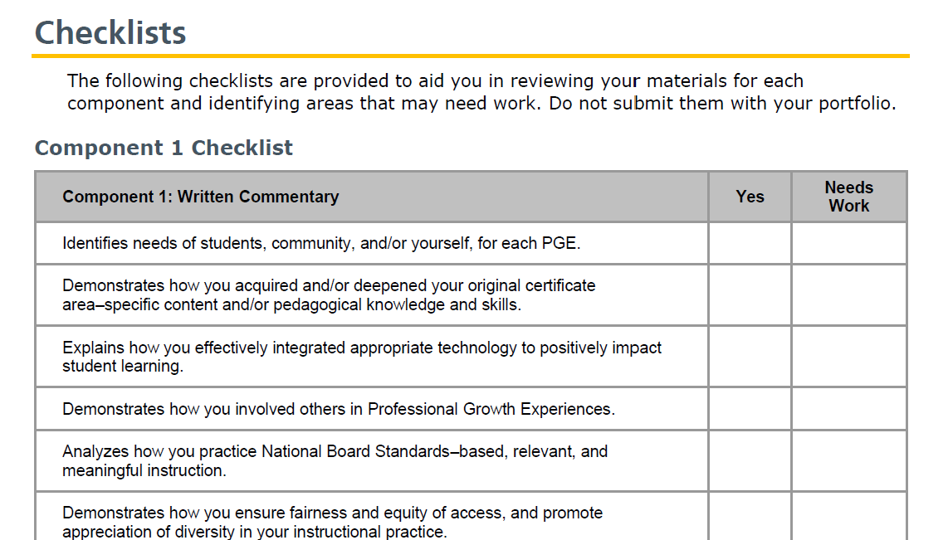
Checklists
MOC Instructions, pages 26-27
Notes:
Melissa P

Slide 44
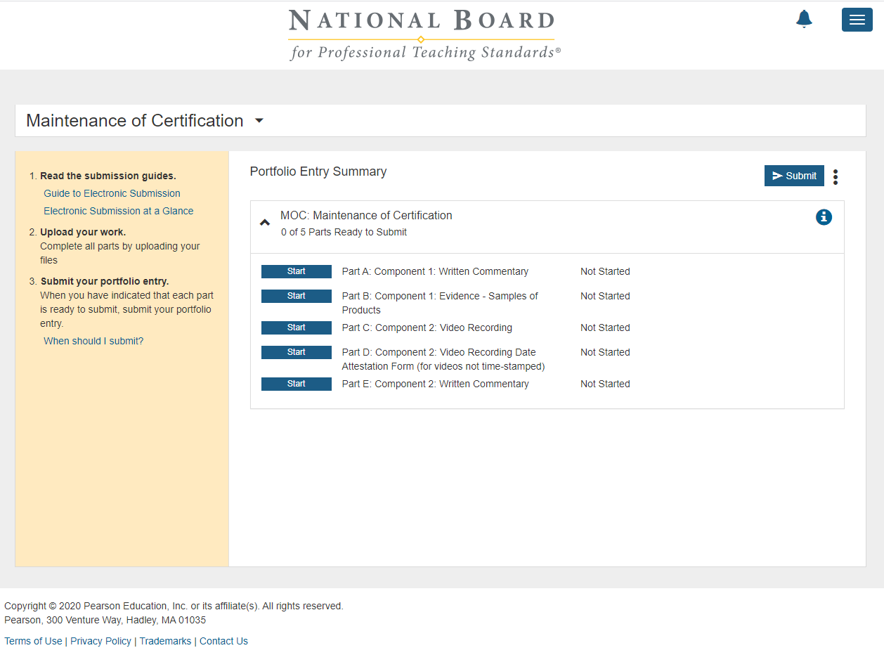
Online Submission Platform
Notes:
Melissa P

Slide 45
COVID-19 Considerations
Video
Videos of virtual classrooms are allowed
Videos of virtual classrooms can be split screen recording or videoed with a camera that captures the teacher at the computer with students on the screen.
MOC candidate must be seen and heard interacting with their students in the Component 2 video
Students must be seen and heard in the Component 2 video
https://www.nbpts.org/covid-19/
More Video Clarification Coming
Notes:
Lisa

Slide 46
COVID-19 Considerations
Student and Adult Release Forms
Candidates may accept Adult and Student Release forms via email and/or with electronic signature in the event they cannot collect hand-signed physical copies. Candidates may create their own forms or use forms, but they must use the same language used on the National Board’s Release Forms.
Attestation Form
Video date attestation forms do not have to be submitted with a handwritten signature from an administrator or other witness. An email or electronic signature on the video attestation form will be accepted. Attestation from a teacher of record, other than yourself, is also acceptable.
Notes:
Lisa

Slide 47
Anonymity
Candidates should try to preserve anonymity throughout their entire portfolio, including their videos, in accordance with the MOC Guide and Instructions and component instructions. Candidates using video of virtual classroom(s) should do their best to set up the video so that only students’ or adults’ first name is displayed in the video.
However, if you are unable to remove personal identifiers despite all reasonable efforts, submitting a video with personal identifiers will not impact the review of the submission. If a candidate is unable to remove personal identifiers, for any reason, the candidate should submit the video without making any edits to cover names. Editing videos to remove personal identifiers is not an allowed edit.
This exception to allow personal identifiers if they cannot be removed despite all reasonable efforts will not continue after the pandemic.
MOC COVID-19 Page
Notes:
Lisa

Slide 48
COVID
Emerging Challenges
Not using video conferencing for virtual teaching
Using video conferencing but not permitted to record
NBCTs in new roles and don’t have own rostered class and anticipate facing challenges guest teaching
Do not violate district or state policies.
We have heard from some teachers that their districts have offered flexibility around not recording. If you are interested in opening up that conversation in your district, here are some resources from a candidate support provide:
Letter
Starter Talking Points
Notes:
Lisa

Slide 50
Additional Supports
State Pages
National Board Networks
Facebook Groups

Slide 51
Closing Reflection
What is one thing you want to do based on what you learned today?
Find an MOC partner
Brainstorm PGEs
Read your current standards
Read the 5 Core Propositions
...
When do you want start that by?

